Slide 1

NLP Project Matrix Factorization Techniques for Recommender Systems
By: Rwad Khatib, Michael Gudovsky, Erez Mahalu, Andrey Dodon

Slide 2
Table Of Content
Introduction to Recommender Systems
Collaborative Filtering
Neighborhood/Latent Models
Reminder - SVD
Matrix Factorization Techniques
References
Summary
Sentiment Analysis
Code Overview
Results and Comparison

Slide 3
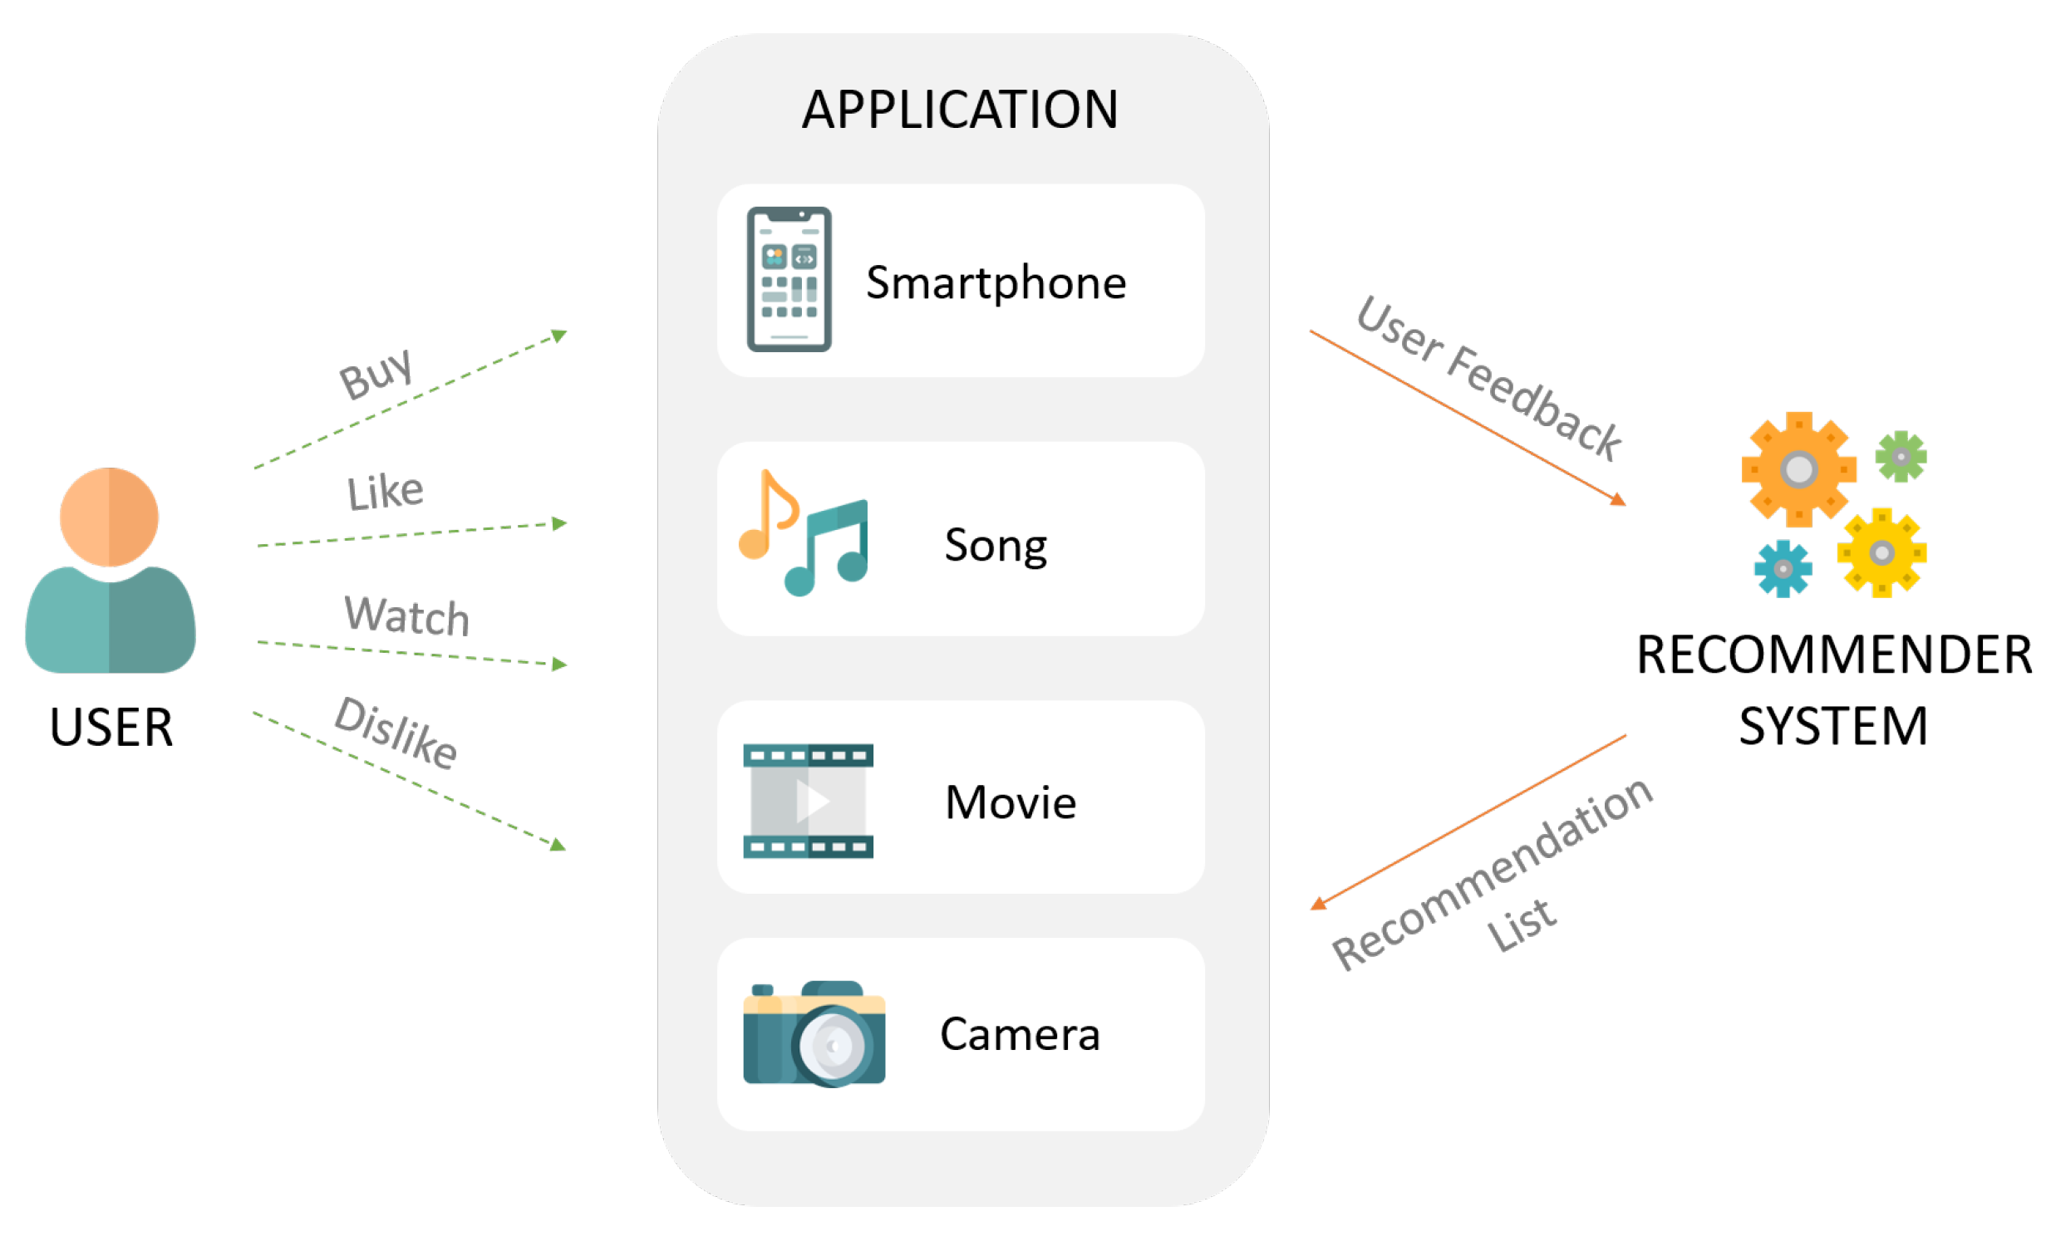
Introduction to Recommender Systems
System that produces user specific recommendations of items based on patterns of ratings or usage

Slide 4
Introduction to Recommender Systems
Recommender systems
Content – based filtering
Collaborative filtering
Hybrid filtering

Slide 5
Content-Based Filtering (CBF)
Item domain-dependent algorithm
Generates predictions via analysis of items attributes
Other users does not influence recommendation
Most successful when content is web pages/publications/news
Recommender Systems
Content-based filtering
Collaborative filtering
Neighborhood Models
Hybrid filtering
Latent Models
User-Item matrix
User-User Based
Item-Item Based
Cons
Items metadata dependent
Items content overspecialization
Pros
No Cold start issues
Recommendation Accuracy independent of user preferences
User Privacy
Interpretability
Content-Based Filtering (CBF)
Collaborative Filtering (CF)
Hybrid Filtering
Overview

Slide 6
Collaborative Filtering (CF)
Domain-independent prediction technique
Suitable for movies/music
Content that can’t easily described by metadata
Build user-item matrix of preferences per items by users
Calculate similarities between users’ profiles to make recommendations
Recommender Systems
Content-based filtering
Collaborative filtering
Neighborhood Models
Hybrid filtering
Latent Models
User-Item matrix
User-User Based
Item-Item Based
Cons
Cold Start
Data Sparsity
Synonymy
Pros
Provide user custom recommendations
No domain knowledge necessary
Doesn’t need contextual features
Scalability
Collaborative Filtering (CF)
Content-Based Filtering (CBF)
Hybrid Filtering
Overview

Slide 7
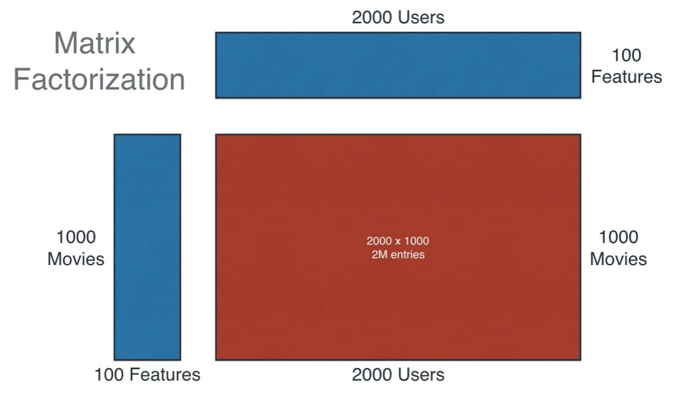
Collaborative Filtering - Matrix Factorization Example

Slide 8
Hybrid Filtering
Combines the previous recommendation techniques
The goal is to provide more accurate recommendations
Like ensemble methods
Overcome limitations of single recommendation model
Recommender Systems
Content-based filtering
Collaborative filtering
Neighborhood Models
Hybrid filtering
Latent Models
User-Item matrix
User-User Based
Item-Item Based
Hybrid Filtering
Content-Based Filtering (CBF)
Collaborative Filtering (CF)
Overview

Slide 9
System Input
Recommender systems rely on two types of inputs
Explicit feedback:
where users directly report on their interest in product
Ratings for movies
Hitting thumbs up/down (Not always available)
Implicit feedback:
which indirectly reflects opinion through observing user behavior
Purchase history
Browsing history
Search patterns
Overview
Content-Based Filtering (CBF)
Collaborative Filtering (CF)
Hybrid Filtering

Slide 10
Collaborative Filtering
CF systems need to relate two fundamentally different entities:
Items & Users
Outcome: User specific recommendations of items based on patterns of rating or usage without need for exogenous information about either items or users
2 main techniques of CF:
Collaborative filtering
Neighborhood Models
Latent Models

Slide 11
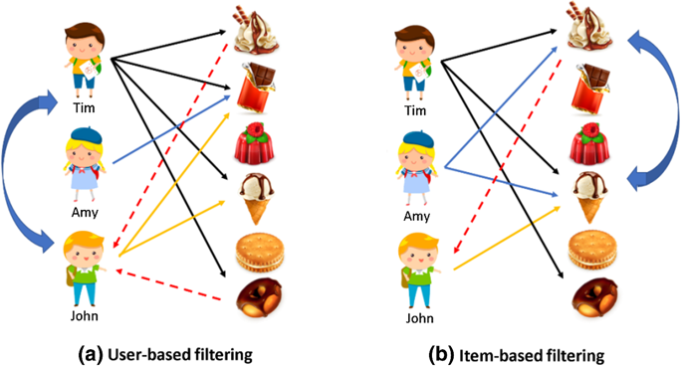
Collaborative Filtering Neighborhood Models
This model relays on the similarity of user-user / item-item
user-user methods estimate unknown ratings based on recorded rating of likeminded users
Item-item methods estimate rating using known ratings made by the same user on similar items
Can provide immediate recommendations based on newly entered user feedback
Interpretability, provide intuitive explanation of recommendations

Slide 12
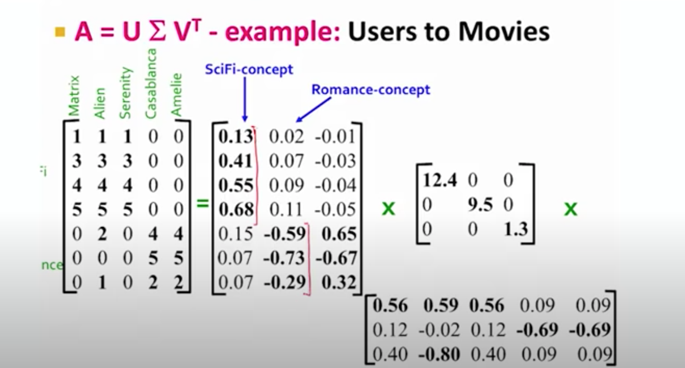
Reminder – Single Value Decomposition (SVD)
Mapping User/Movies interaction data to low-dimensional representation
Latent Semantic embedding: We use SVD in order to Discover hidden concepts

Slide 13
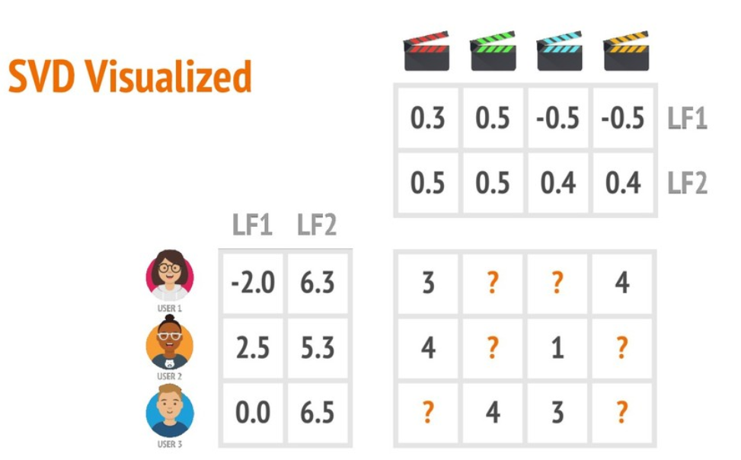
Reminder – Single Value Decomposition (SVD)
Compute item similarity based on the inner product in this latent semantic space
Two sets of similar user features
imply two similar minded users
e.g., two users with different user features values
e.g., two movies with similar features values

Slide 14
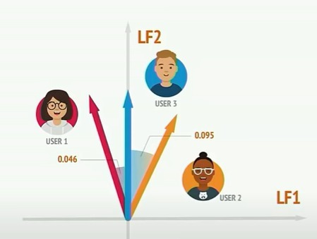
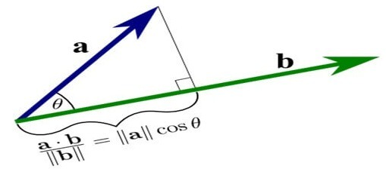
Reminder – Single Value Decomposition (SVD)
E.g. Cosine similarity:
Similar features map to similar
location in low dimensional space

Slide 15
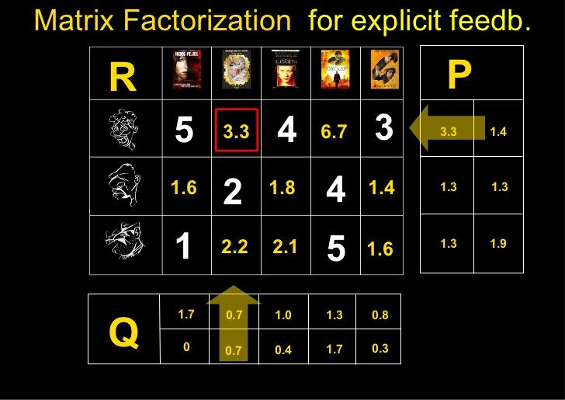
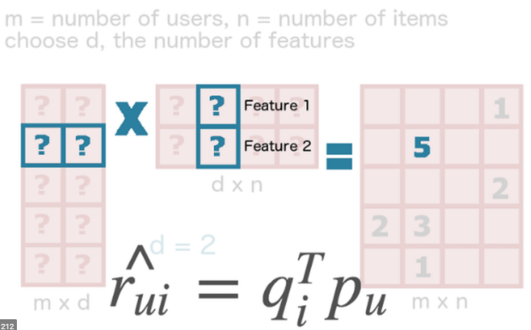
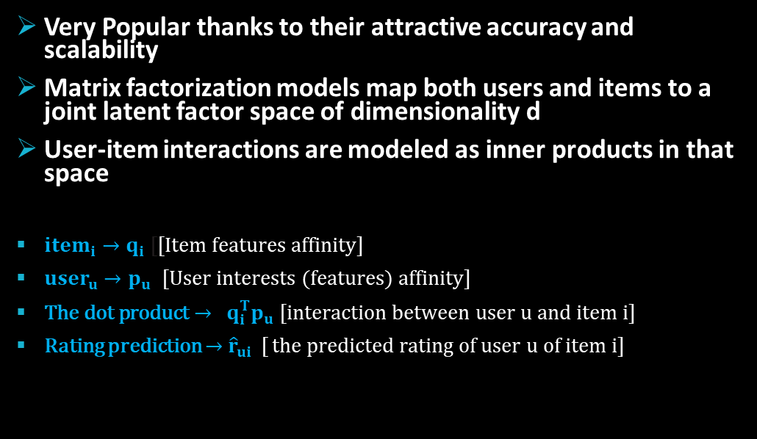
CF Latent Models - Matrix Factorization
Very Popular thanks to their attractive accuracy and scalability
Matrix factorization models map both users and items to a joint latent factor space of dimensionality d
User-item interactions are modeled as inner products in that space
$item_{i}→q_{i}$[[Item features affinity]
$user_{u}→p_{u}$ [User interests (features) affinity]
$\text{The} \text{dot} \text{product}→$ ${ q}_{i}^{T}p_{u}$ [interaction between user u and item i]
Rating prediction $→$ ${\hat{r}}_{ui}$ [ the predicted rating of user u of item i]

Slide 16
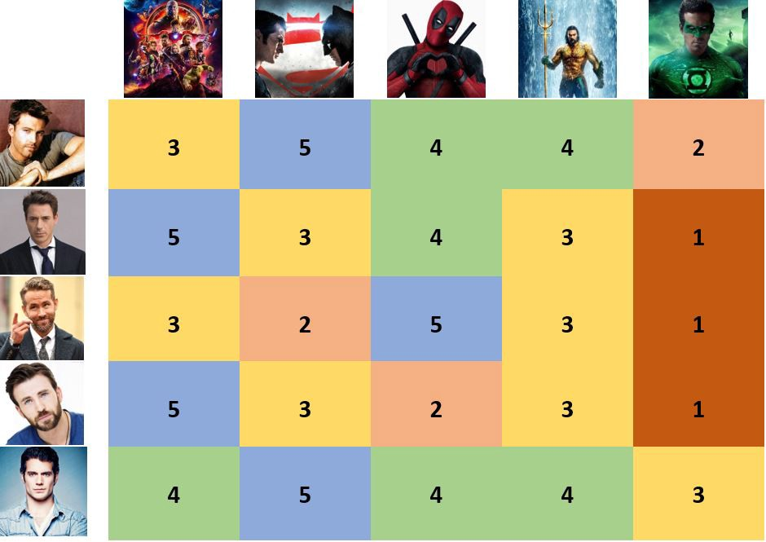
SVD Single Vector Decomposition
SVD ++
Time SVD++
Matrix Factorization
Models

Slide 17

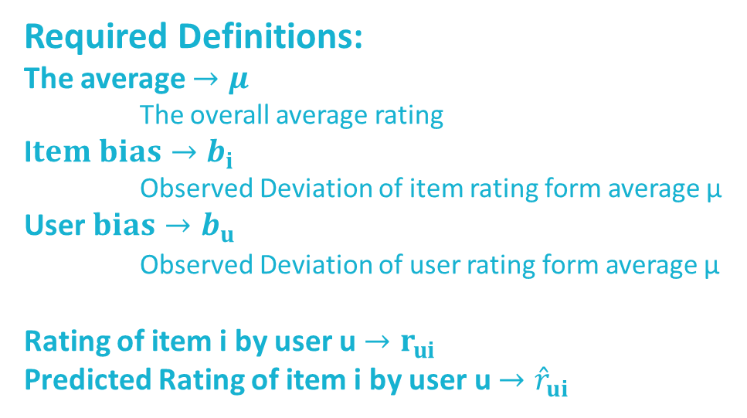
Single Value Decomposition
Explain ratings by characterizing users & items on learned features
Features inferred form users' feedbacks
E.g. in movies features might measure dimensions such as comedy vs.
drama, amount of action…
SVD produces latent 2 lower dimension matrixes (Q & P)
The inner product ${ q}_{i}^{T}p_{u}$ shall retrieve $r_{ui}$.
The final rating prediction created by adding the baseline predictors ${\hat{r}}_{ui}^{SVD}=μ+b_{i}+b_{u}+q_{i}^{T}p_{u}$
Required Definitions:
The average $→μ$
The overall average rating
I$tem bias→b_{i}$
Observed Deviation of item rating form average μ
User$bias→b_{u}$
Observed Deviation of user rating form average μ
$μ$ , $b_{i},b_{u}$are called Baseline predictors
Rating of item i by user u $→r_{ui}$
Predicted Rating of item i by user u $→{\hat{r}}_{ui}$
SVD
SVD ++
Time SVD ++
Comparison

Slide 18

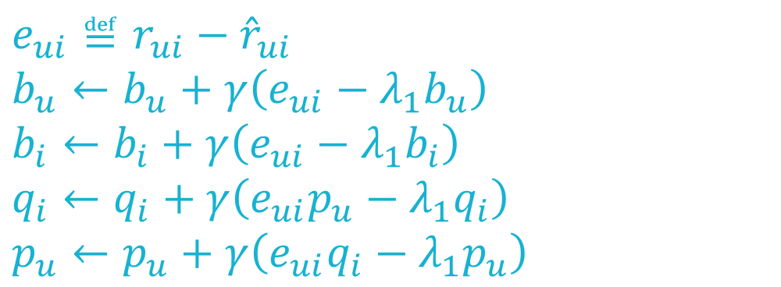
We learn the model parameters by minimizing the regularized squared error
$$\min_{b_{∗},q_{∗},p_{∗}}{\sum_{(u,i)∈Κ}{{\left(r_{ui}−μ−b_{i}−b_{u}−q_{i}^{T}p_{u}\right)}^{2}+λ_{1}(b_{i}^{2}+b_{u}^{2}+{\left\|q_{i}\right\|}^{2}+{\left\|p_{u}\right\|}^{2})}}$$
Minimization is typically performed by either stochastic gradient decent or alternating least squares
$λ_{1}$ - Controls the extent of regularization is determined by cross validation
$γ$ – Learning rate, value is obtained via cross validation
$e_{ui}≝r_{ui}−{\hat{r}}_{ui}$
$$b_{u}←b_{u}+γ\left(e_{ui}−λ_{1}b_{u}\right)$$
$$b_{i}←b_{i}+γ\left(e_{ui}−λ_{1}b_{i}\right)$$
$$q_{i}←q_{i}+γ\left(e_{ui}p_{u}−λ_{1}q_{i}\right)$$
$$p_{u}←p_{u}+γ\left(e_{ui}q_{i}−λ_{1}p_{u}\right)$$
(The above equations are in reference to stochastic gradient decent)
SVD
SVD ++
Time SVD ++
Comparison

Slide 19
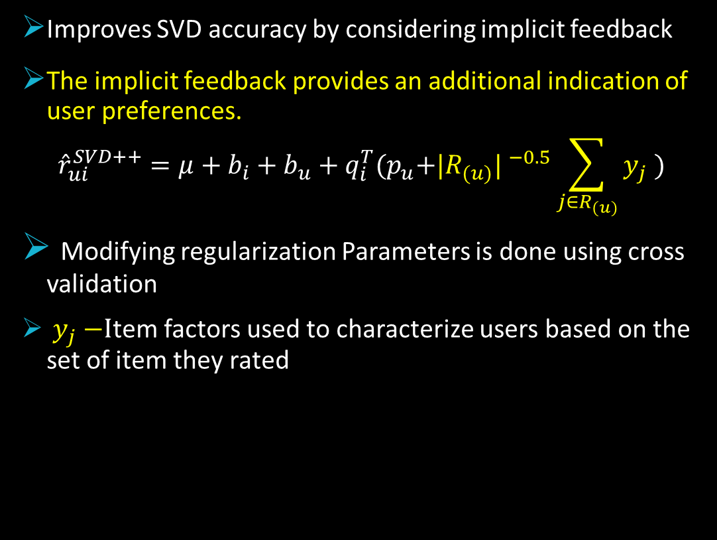
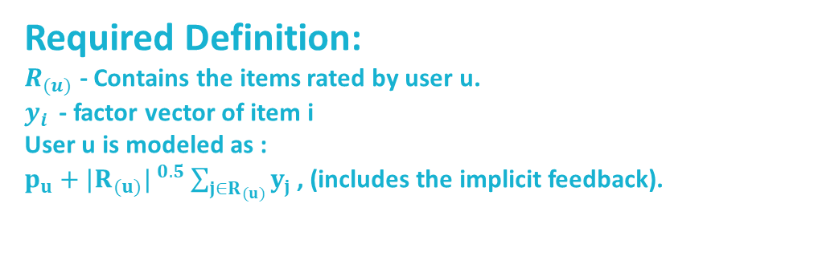
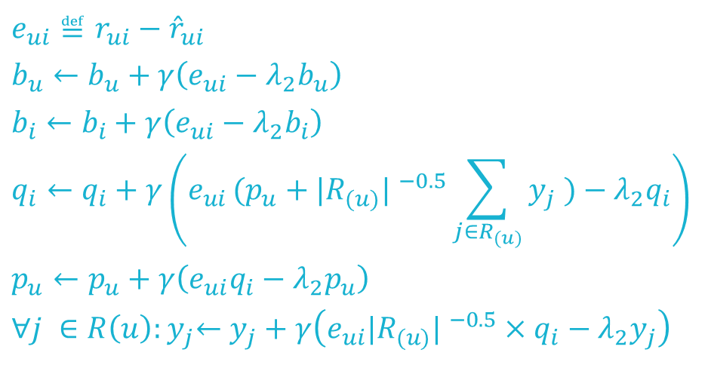
SVD ++
Improves SVD accuracy by considering implicit feedback
The implicit feedback provides an additional indication of user preferences.
$${\hat{r}}_{ui}^{SVD++}=μ+b_{i}+b_{u}+q_{i}^{T}{(p}_{u}+{|R_{(u)}| }^{−0.5}\sum_{j∈R_{(u)}}{y_{j}} )$$
Modifying regularization Parameters is done using cross validation
${ y}_{j} −I$tem factors used to characterize users based on the set of item they rated
Required Definition:
$R_{(u)}$ - Contains the items rated by user u.
$y_{i }$- factor vector of item i
User u is modeled as :
$p_{u}+{|R_{(u)}| }^{0.5}\sum_{j∈R_{(u)}}{y_{j}}$, (includes the implicit feedback).
$e_{ui}≝r_{ui}−{\hat{r}}_{ui}$
$$b_{u}←b_{u}+γ\left(e_{ui}−λ_{2}b_{u}\right)$$
$$b_{i}←b_{i}+γ\left(e_{ui}−λ_{2}b_{i}\right)$$
$$q_{i}←q_{i}+γ\left(e_{ui }(p_{u}+{|R_{(u)}| }^{−0.5}\sum_{j∈R_{(u)}}{y_{j}} )−λ_{2}q_{i}\right)$$
$$p_{u}←p_{u}+γ\left(e_{ui}q_{i}−λ_{2}p_{u}\right)$$
$${∀j ∈R\left(u\right):y}_{j}←y_{j}+γ\left(e_{ui}{|R_{(u)}| }^{−0.5}×q_{i}−λ_{2}y_{j}\right)$$
SVD ++
SVD
Time SVD ++
Comparison

Slide 20



Time SVD ++
$\text{Improves} \text{SVD}\text{++ }\text{by} \text{considering} \text{temporal} \text{effects}$
$\text{We} \text{identify} \text{the} \text{following} \text{affects} \text{that} \text{each} \text{vary} \text{over} \text{time}\text{:}$
$\text{User} \text{biases} b_{u}→b_{u}(t_{ui})$
$\text{Item} \text{biases} b_{i}→b_{i}(t_{ui})$
$\text{User} \text{preferences} p_{u}→p_{u}(t_{ui})$
$t_{ui}$ - Template for a time sensitive baseline predictor
$${\hat{r}}_{ui}^{timeSVD++}=μ+b_{i}(t_{ui})+b_{u}(t_{ui})+q_{i}^{T}{(p}_{u}(t_{ui})+{|R_{(u)}| }^{−0.5}\sum_{j∈R_{(u)}}{y_{j}} )$$
Time SVD ++
SVD
SVD ++
Comparison

Slide 21


Comparison
SVD
SVD ++
Time SVD ++
SVD is well established for identifying latent semantic factors
Conventional SVD is undefined when knowledge about the matrix is incomplete
Relatively few known entries may cause overfitting
Prediction accuracy improves by considering implicit feedback
Helpful for users that provides much more implicit feedback
Does not consider the temporal trends
Prediction accuracy improves by considering temporal effects
Decomposing ratings into distinct terms use to treat different temporal aspects separately
Comparison
SVD
SVD++
Time SVD ++

Slide 22
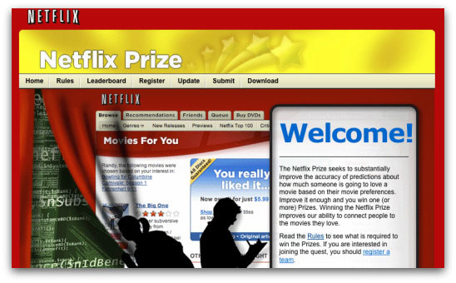
Project Description Netflix Data set
Given The Netflix Data set (1999 – 2005)
100 M dated movie rating by unanimous users
Rating scale 1-5
480,000 users & 17,770 movies
Quality of Results is considering RMSE
Also given Test set of 1.4 M ratings (Quiz set)
The goal is to improve movie rating prediction accuracy as much as possible (for specific user)

Slide 23
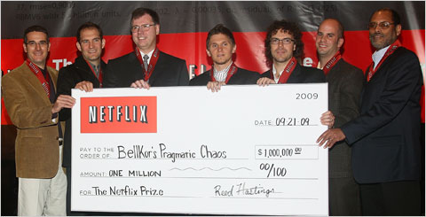
Project Description Netflix Data set
The winner algorithm use SVD model!

Slide 24
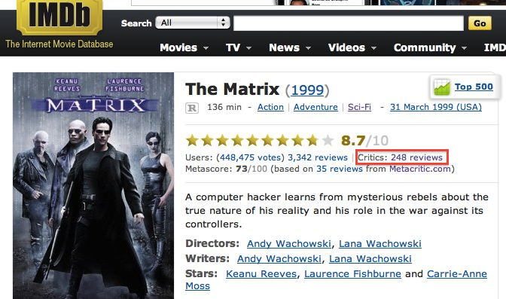
Project Study Case
Using Movies Reviews from IMDB in order to modify the item bias
Evaluate if the updated bias increases prediction accuracy
Bias update acquired using NLP models
Our assumption is that integrating independent external explicit data source could increase both variance of data and prediction accuracy

Slide 25
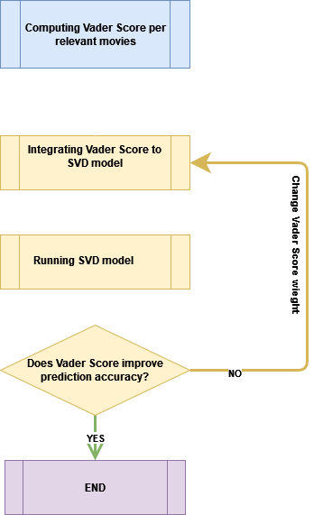
Work flow

Slide 26
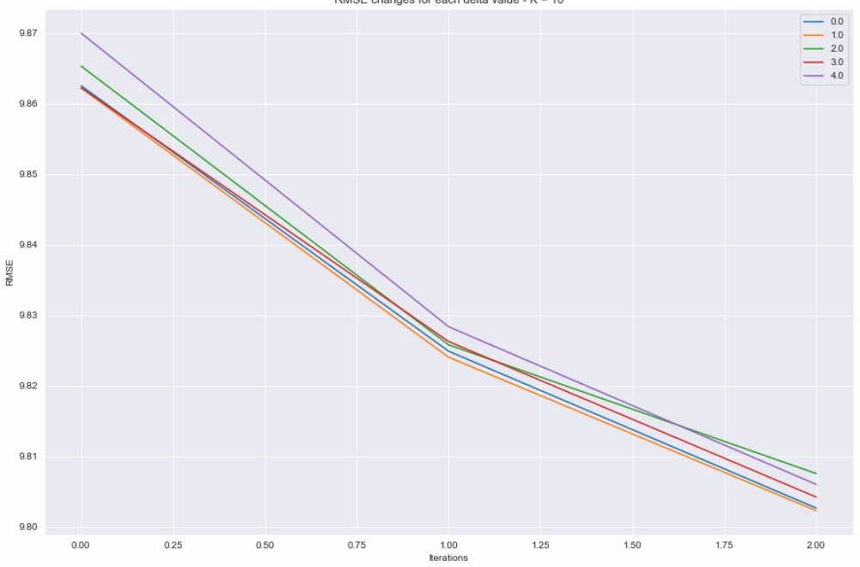
Code Review – Updated biases effect on RMSE
RMSE vs. Iteration #
3 iterations
K(features) = 10
Cold Start is improved by using Vader score bias update

Slide 27
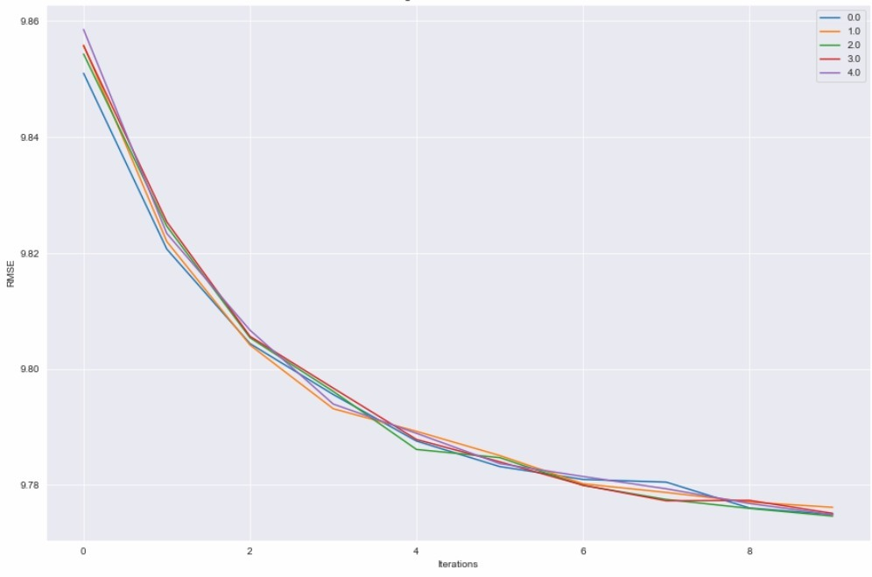
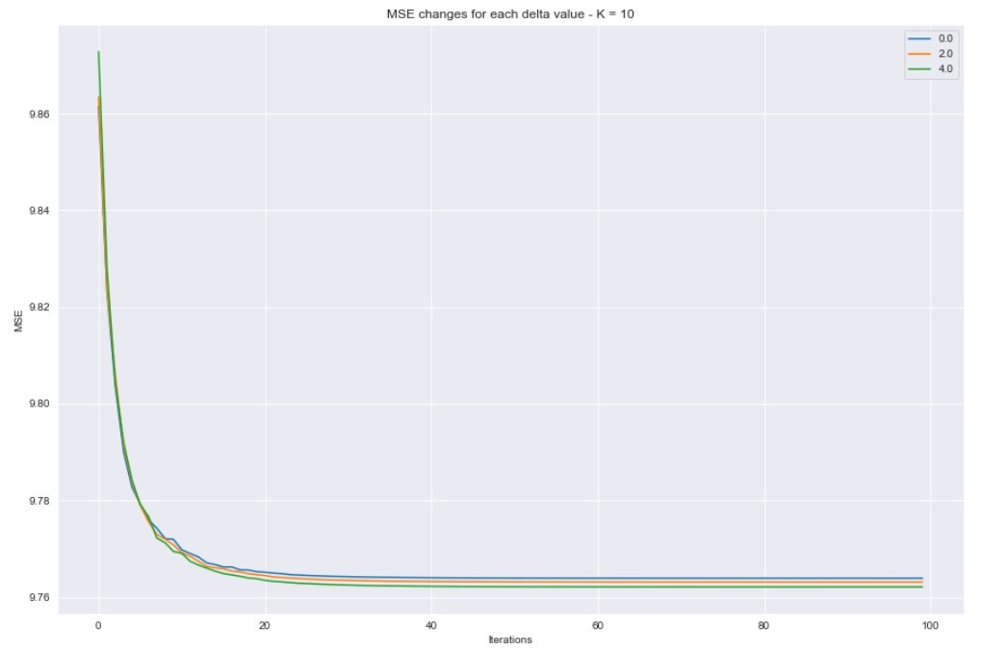
Code Review – Updated biases effect on RMSE
RMSE vs. Iteration (K = 50)
RMSE vs. Iteration (100 Iterations)

Slide 28
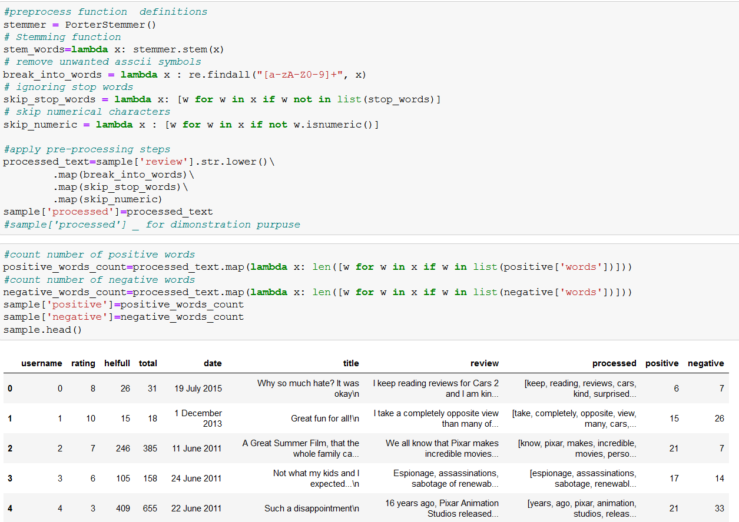
Sentiment Analysis & preprocessing – Code Review
IMDB review (the implicit data) have been preprocessed in order to:
Remove stop words
Stemming
Remove unwanted ascii symbols
Skip numerical characters
Identifying positive words and negative words

Slide 29
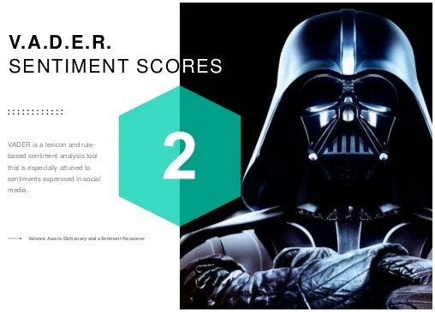
Sentiment Analysis
We use Vader (Valence Aware Dictionary for Sentiment Reasoning) , which is a part of the NLTK module designed for sentiment analysis
Vader uses a lexicon of words to find which ones are positives or negatives.
It considers the context of the sentences to determine the sentiment scores
Vader model includes built-in preprocessing
Vader applies Tri_Gram context model
Vader returns 4 values for each text:
Positive score
Neutral score
Negative score
Overall score

Slide 30
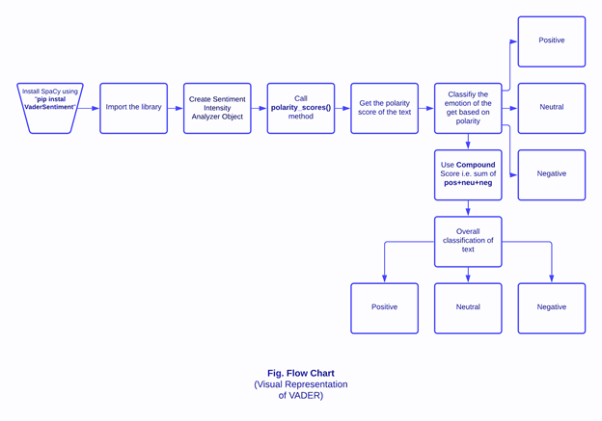

Sentiment Analysis – Vader Flow Chart
Vader is a model used for text sentiment analysis that is sensitive to both polarity (positive/negative) and intensity (strength) of emotion.
It relies on a dictionary that maps lexical features to emotion intensities known as sentiment scores
The sentiment score of a text obtained by summing up the intensity of each word in the text
The compound score is calculated from $x= \frac{x}{\sqrt{x^{2}+α}}$
where X sum of valence scores of constituent
words and α is normalization constant

Slide 31
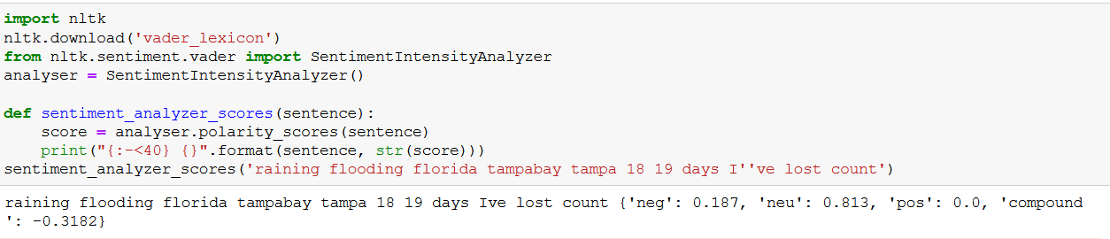
Sentiment Analysis - Vader Example

Slide 32
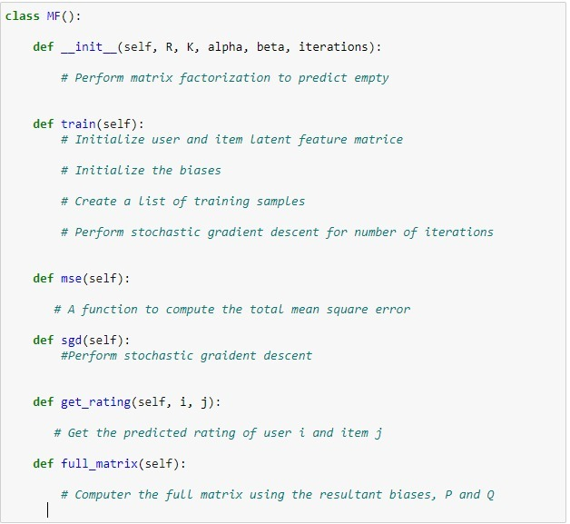

SVD Model
We used MF class created by Yehuda Koren, Robert Bell, Chris Volinsky
GitHub Paper-Implementation-Matrix-Factorization-Recommender-Systems-Netflix reference could be found in references section
MF Class inputs are:
R (ndarray) : user-item rating matrix
K (int) : number of latent dimensions
alpha (float) : learning rate
beta (float) : regularization parameter
delta (float) : vader score weight
vadar_score : vader score list
Then MF Class:
Train SVD model
Updating parameters and
Calculating MSE and
Performing SGD (stochastic gradient decent) and finally provide predicted rating ${\hat{r}}_{ui}$.

Slide 33

In the next code review we show that external implicit data of item bias (from IMDB site) lead to small improvement in rating prediction accuracy
Considering the results, if given more time we would try to farther improve accuracy by:
Integrating more external implicit data
Adding temporal effects gained from relevant external sources
Train on larger number of movies and users
Decrease sparsity in Database

Slide 34
References
Main paper: Koren, Y., & Bell, R. (2015). Advances in collaborative filtering. In Recommender systems handbook (pp. 77-118). Springer, Boston, MA.
Koren, Y., Bell, R., & Volinsky, C. (2009). Matrix factorization techniques for recommender systems. Computer, 42(8), 30-37.
F.O.Isinkayea, Y.O.Folajimib, B.A.Ojokohc: Recommendation systems: Principles, methods and evaluation. Egyptian Informatics Journal Volume 16, Issue 3, November 2015, Pages 261-273
Songhao Wu, Design your own Sentiment Score, toward data science web
Yehuda Koren, Robert Bell, Chris Volinsky, Paper-Implementation-Matrix-Factorization-Recommender-Systems-Netflix, Github harshraj11584

Slide 35

Any Question?

